Slide 1
Rockbuster Stealth
File created on: 1/22/2023 1:13:44 PM

Slide 2
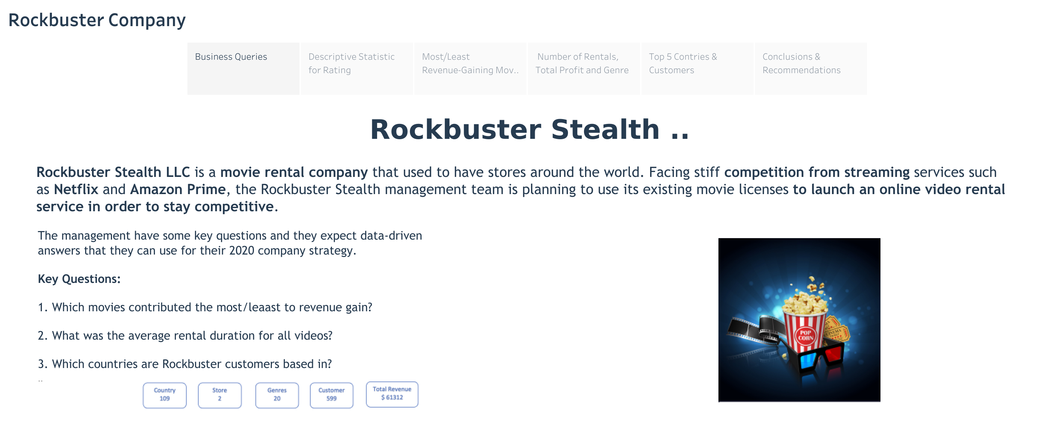

Slide 3
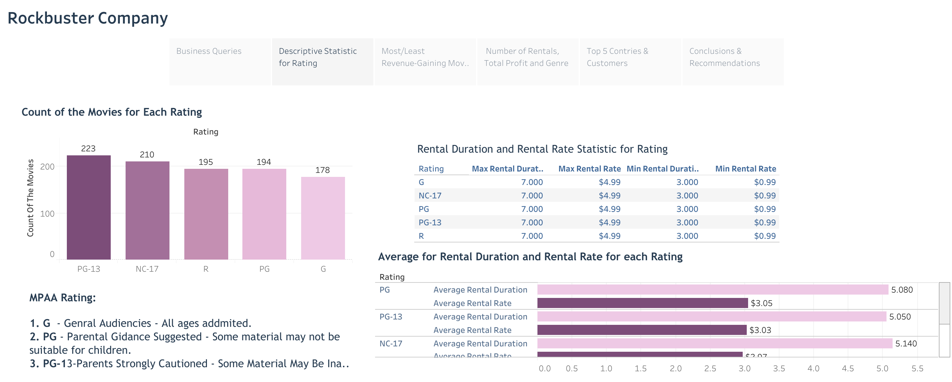

Slide 4
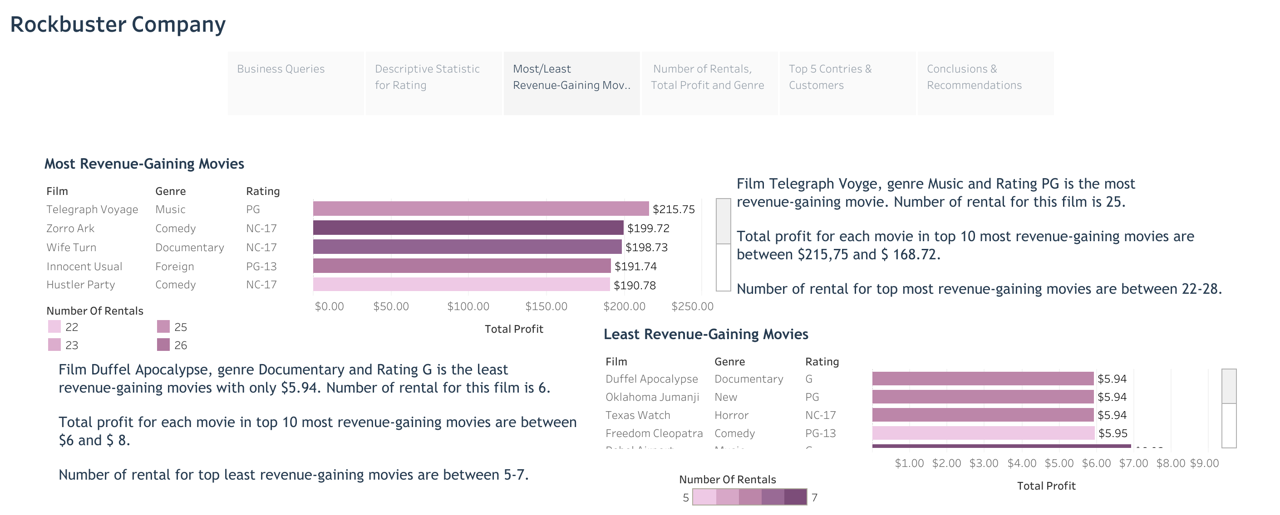

Slide 5
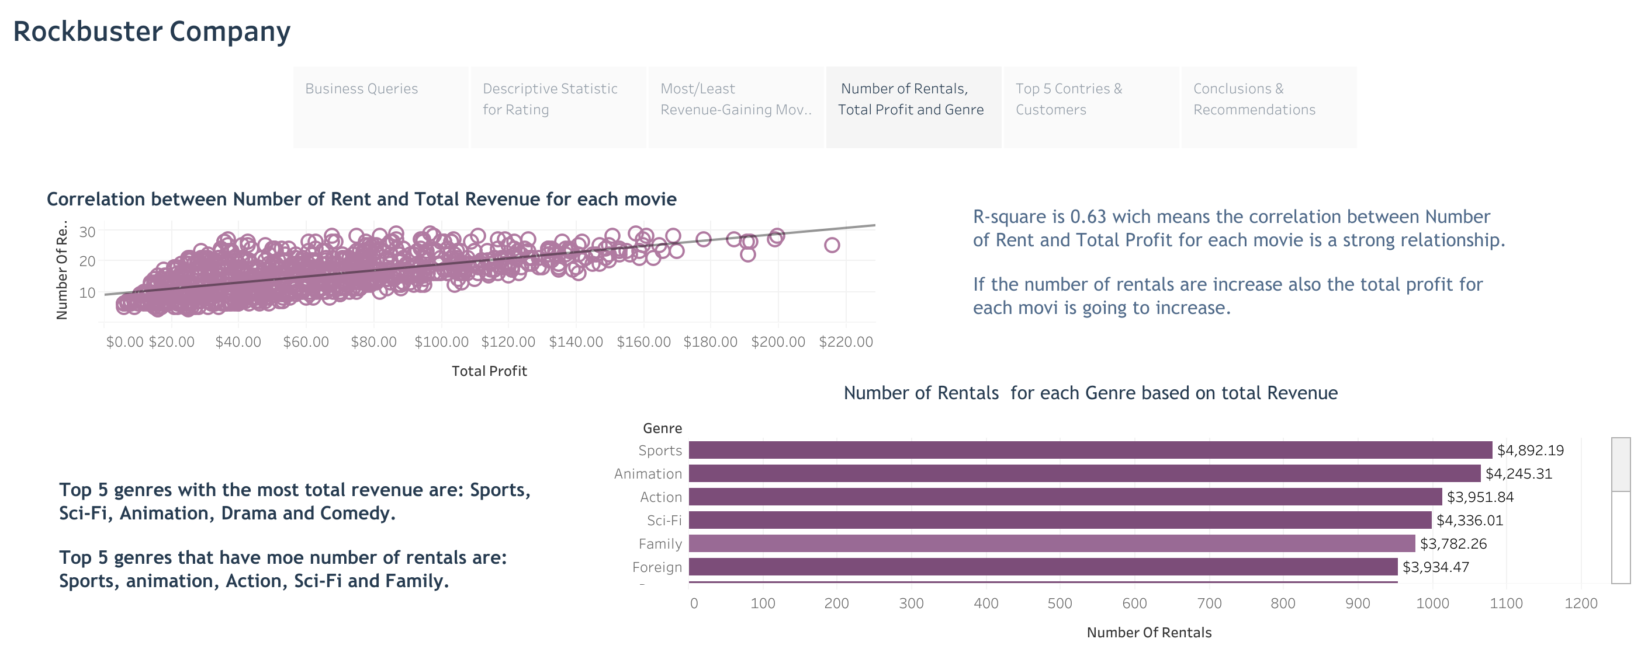

Slide 6
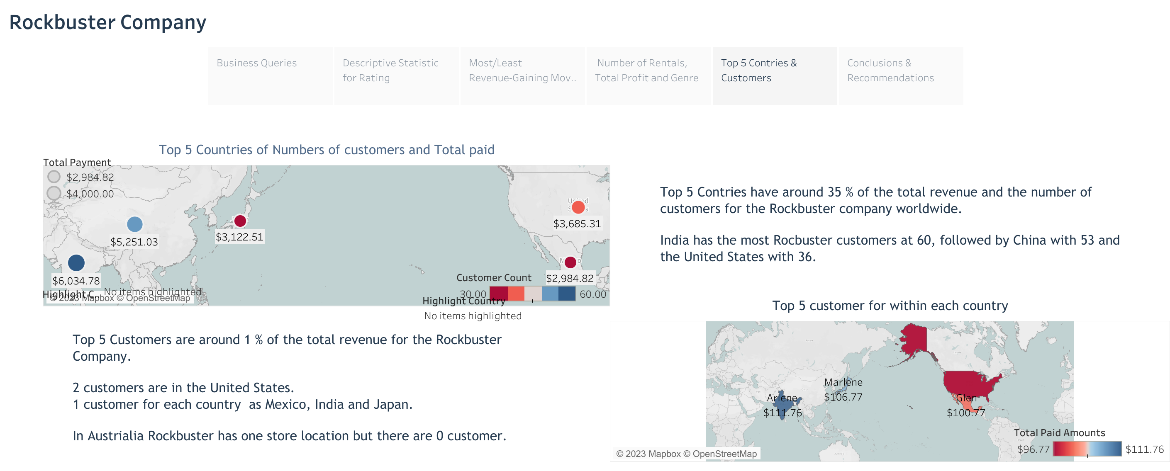

Slide 7
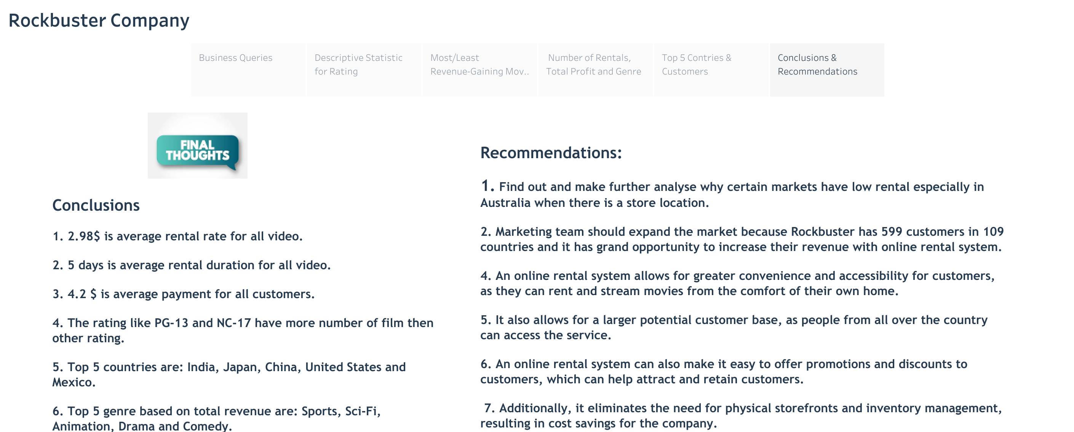

Slide 8
Thank you!
Link Tableau: https://public.tableau.com/app/profile/eriselda.baci/viz/RockbusterStealth_16741209317050/Story1

